Slide 1

How to get a home (mortgage)?
By: Jose Luis Tejada

Slide 2

Home mortgages and how do I get one?
Background:
Homeownership is a key component of the American dream.
Securing a mortgage is a crucial step in achieving homeownership.
The mortgage approval process is often opaque and uncertain.
3.6 - 5.4 million mortgage applications are denied each year (20-30%)
Objective:
Analyze home mortgage data to identify key factors influencing approval decisions.
Develop a prediction model to estimate the likelihood of mortgage approval based on individual characteristics.
Use data analysis and predictive modeling to make the mortgage process more transparent.
Aim to improve understanding of approval criteria and assist individuals in assessing their mortgage prospects.

Slide 3
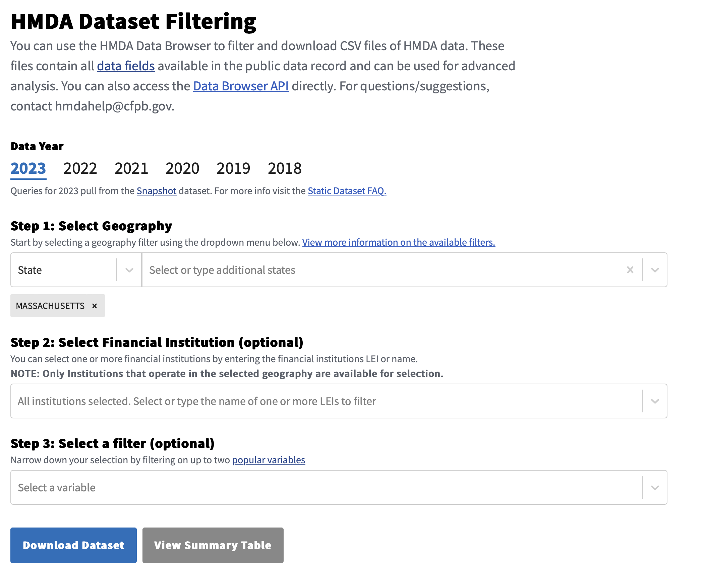
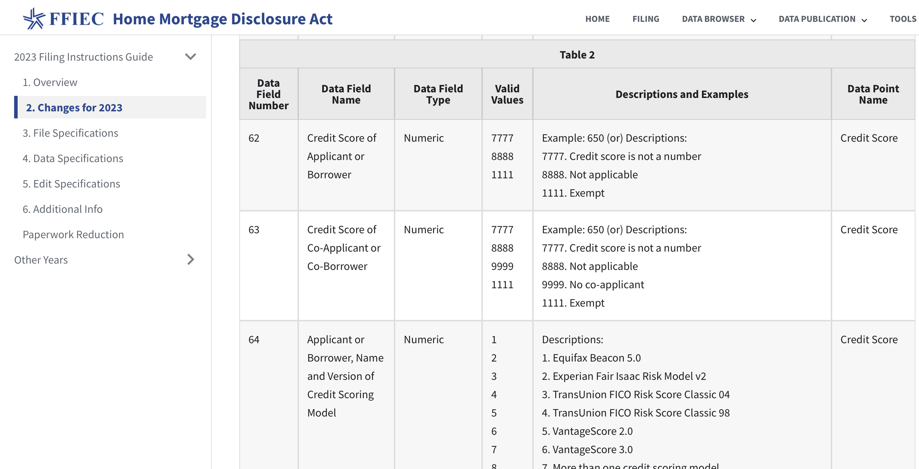
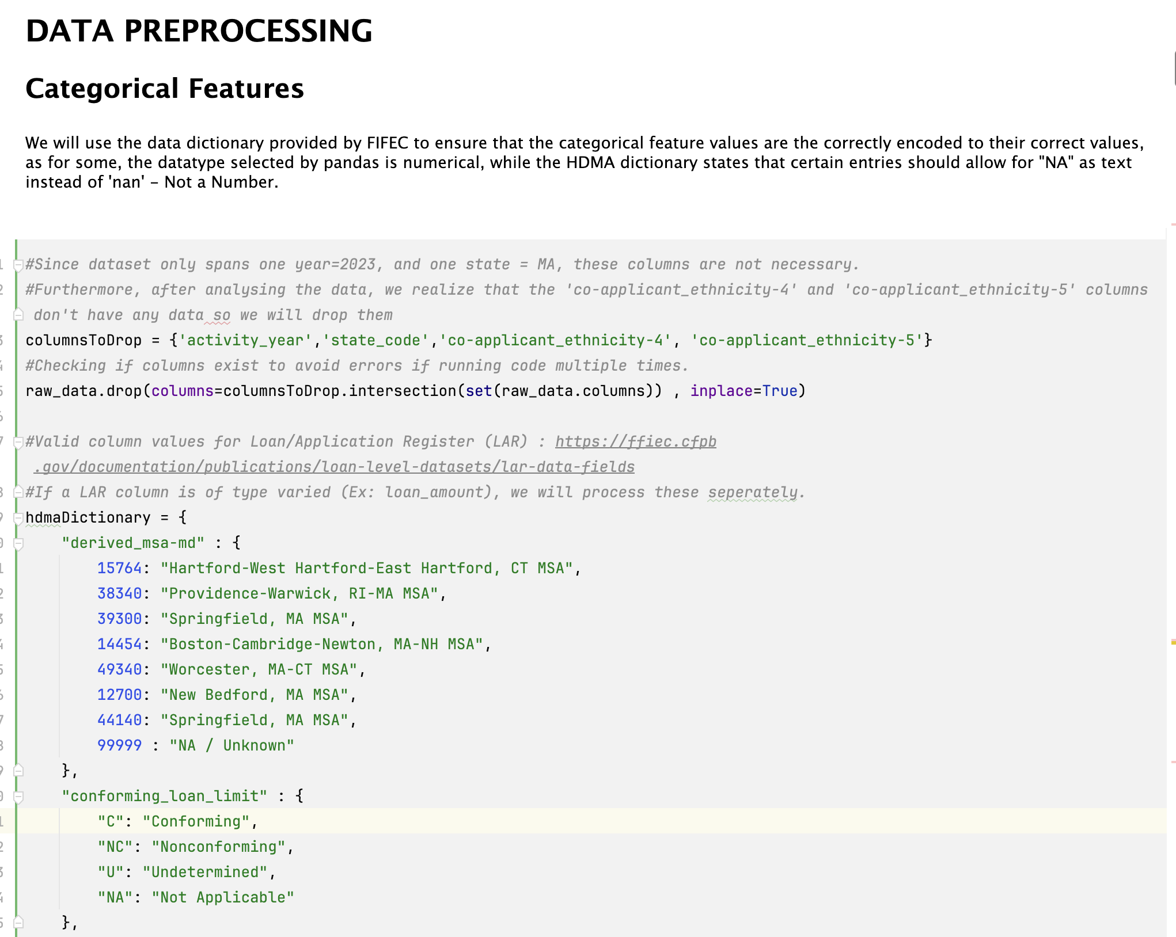
Data Acquisition and Exploration
Data Acquisition:
The Home Mortgage Disclosure Act (HMDA)
The Federal Financial Institutions Examination Council’s (FIFEC) Consumer Financial Protection Bureau (CFPB) provides a trove of information related to mortgage applications, at various stages.
Downloaded dataset for 2023 Massachusetts Mortgages (~210,000 entries, 81MB)
72 Numerical features (But many have “Exempt” Case)
26 Categorical Features
Data Exploration:
Created complete HDMA dictionary to check value entries, convert NA/Nulls, and encode data in expected format as per standard.
Performed univariate analysis for all features.

Slide 4
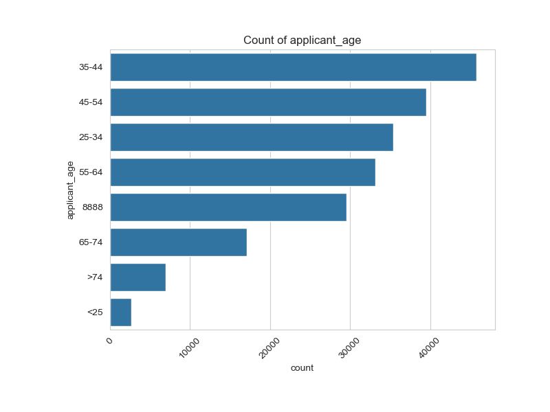
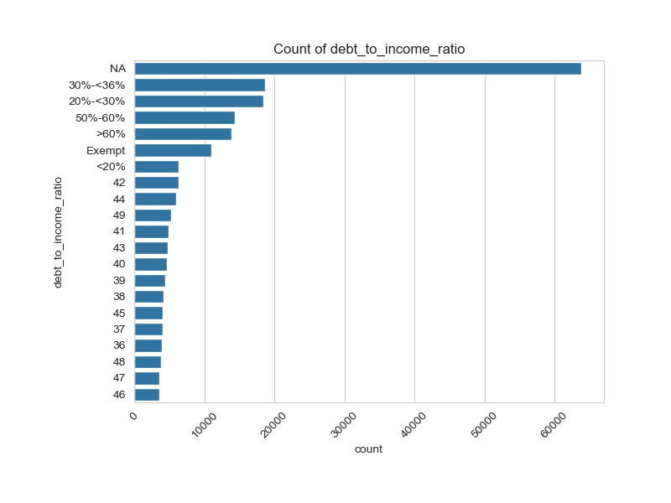
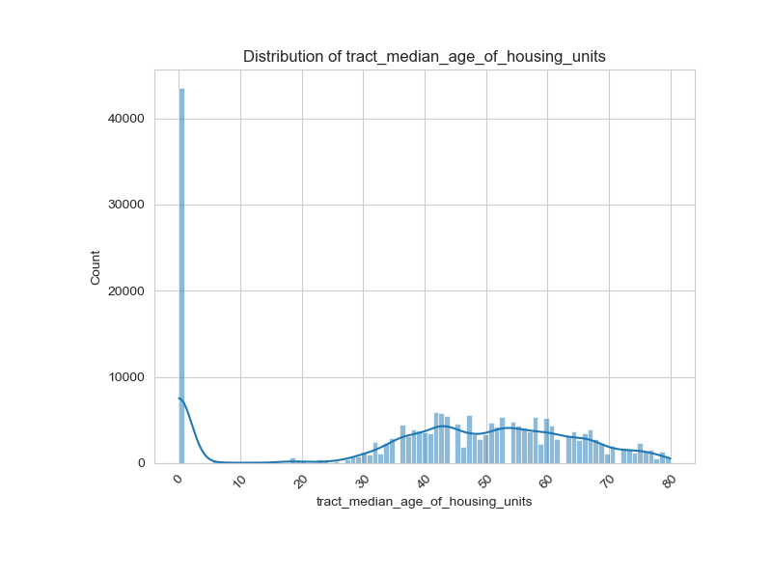
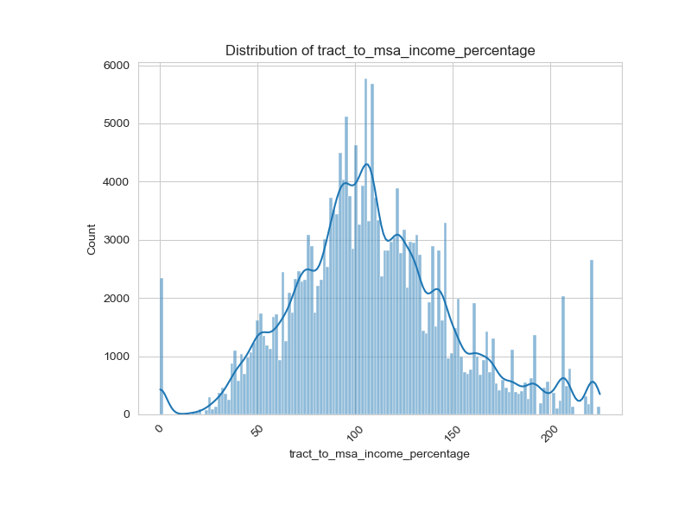
Univariate Analysis Samples

Slide 5
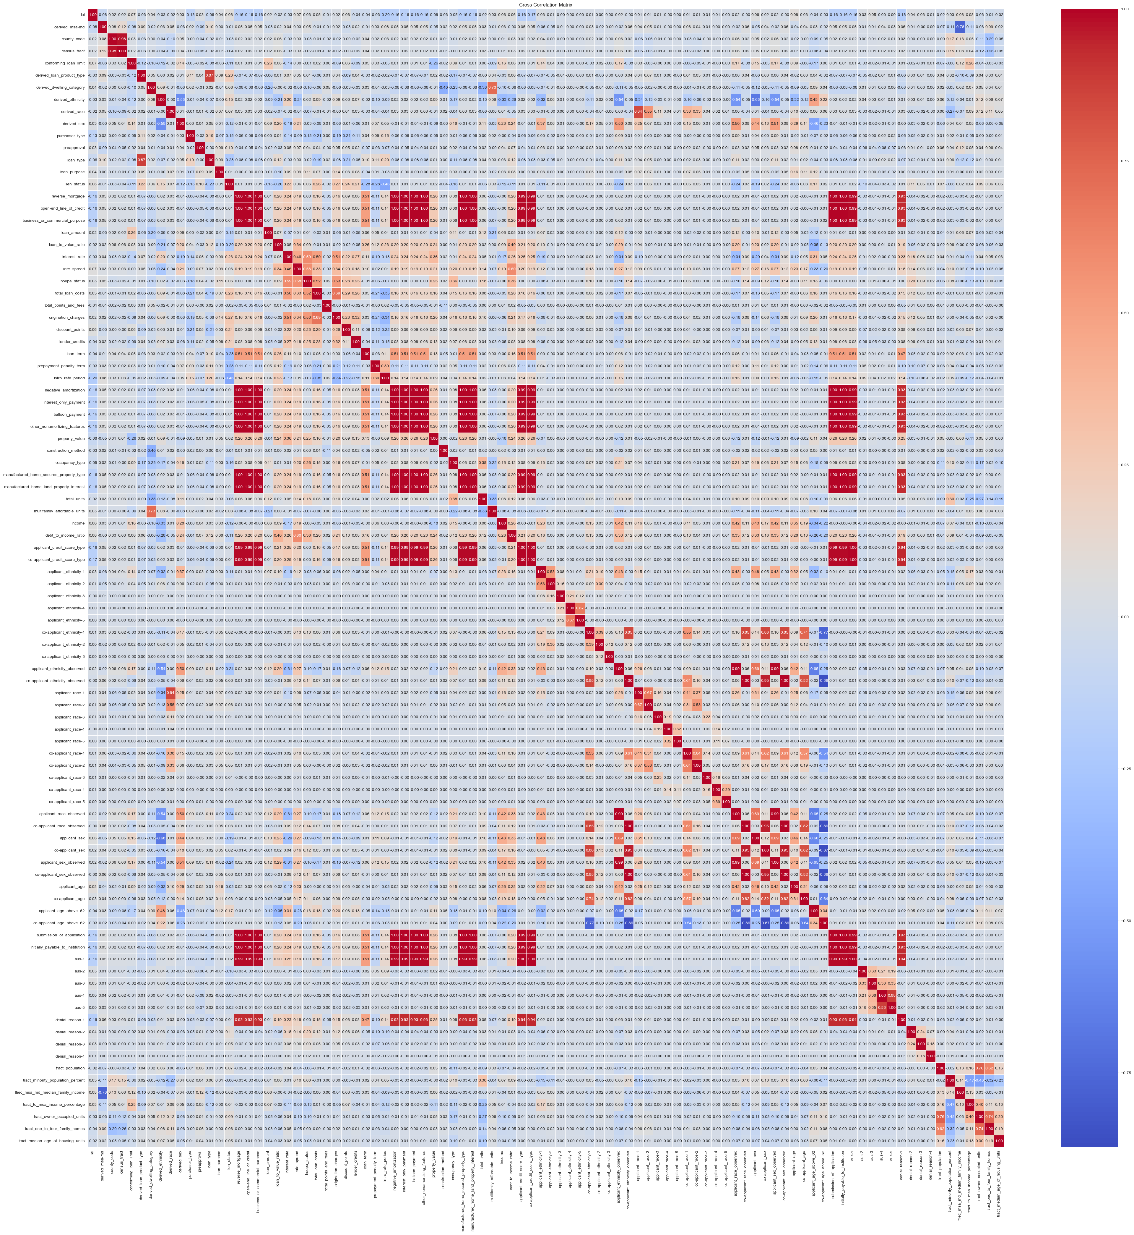
Data Exploration and Feature Selection
Feature Selection:
Dealing with the curse of dimensionality with 98 features was paramount
Noticed that many features were highly correlated with one another and often redundant:
Ex: Loan_Type and Derived_Product_Loan_Type
Used cross correlation matrix do identify highly correlated features (Red = Positive, Blue = Negative)
Dropped feature with correlation above 0.8
Allowed feature space reduction of ~28%.

Slide 6
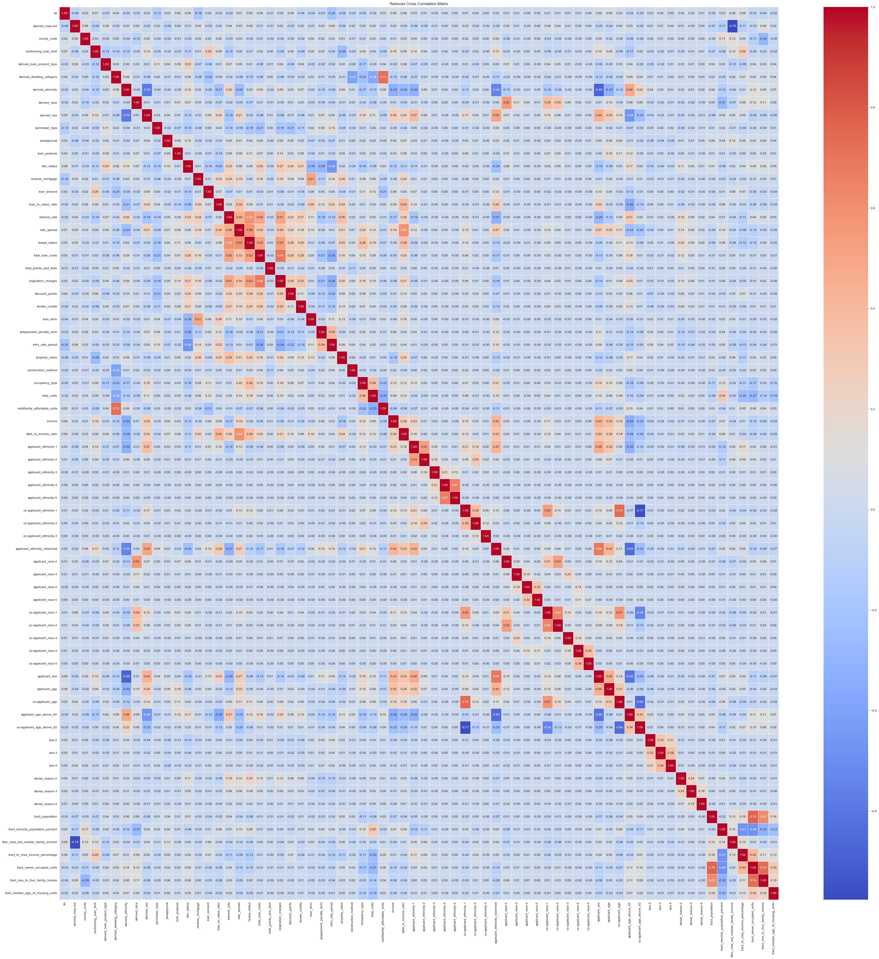
Initial Feature Set
Reduced Feature Set

Slide 7
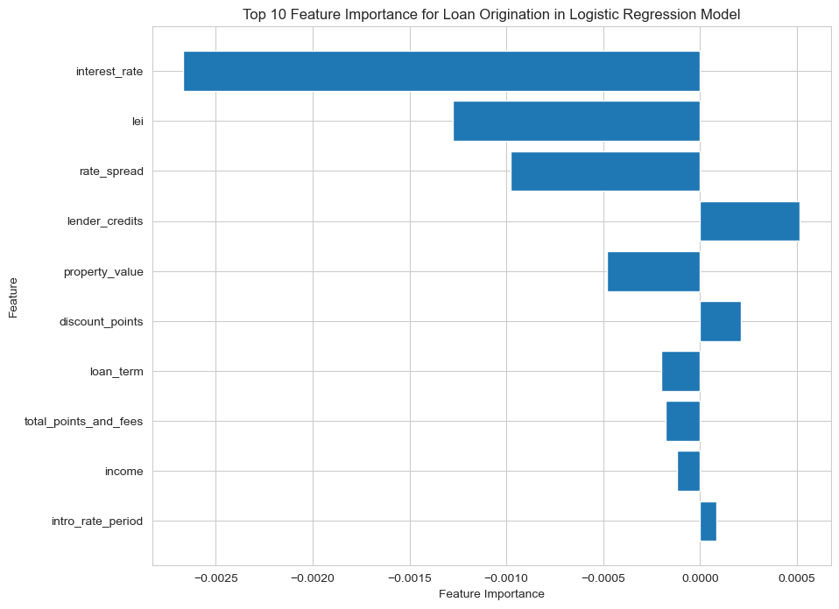
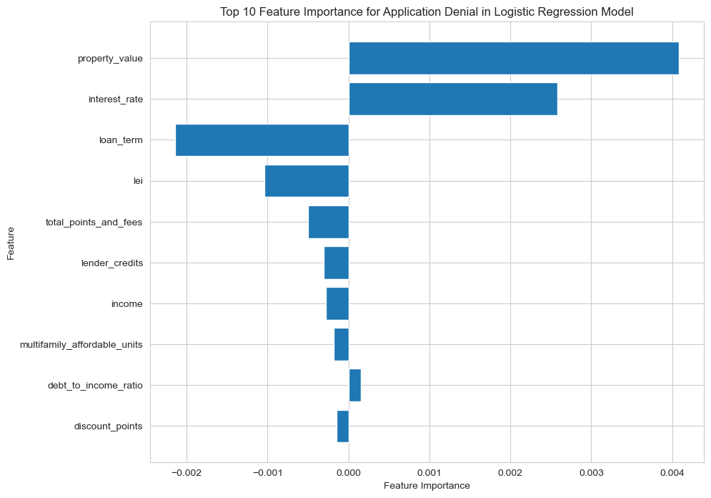
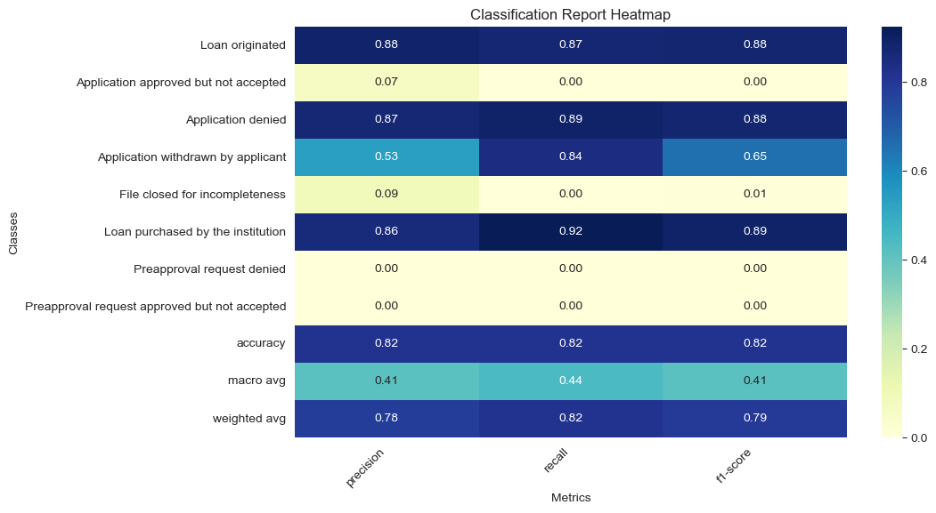
Results
Model: Multinominal Logistic Regression
We have a categorical dependent variable that is multinominal.
Does not assume a linear relationship between features.
Does not assume that the predictor variables or the residuals are normally distributed.
Results:
Performed well for determining Mortgage loan approval or denial.
Didn’t perform as well for under sampled classes. (Classes 2,5,7,8 comprise only 7.2% of dataset)

Slide 8
Loan Origination
Application Denial

Slide 9
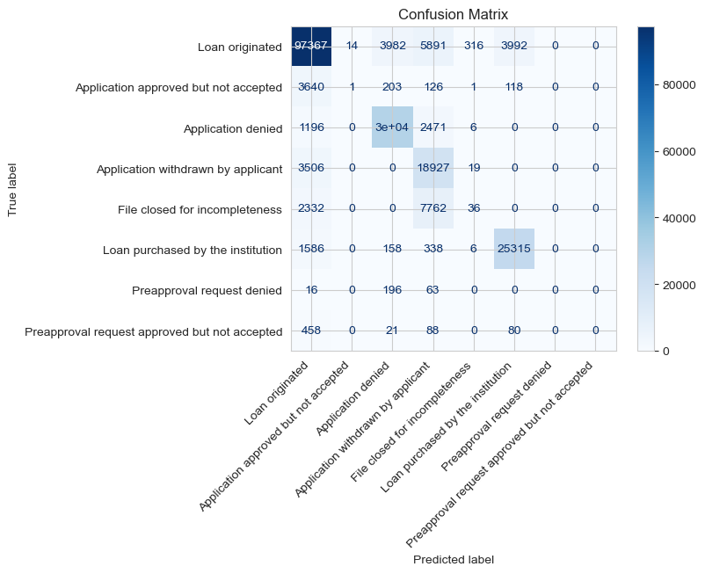
Multinominal Logistic Regression Performance for Mortgage Outcomes

Slide 10
Further Improvements
Potential for improvement of under sampled classes:
SMOTE (Synthetic Minority Over-sampling Technique)
Ensemble Methods
Potential improvements in further feature engineering: income_per_dependent, loan_to_income_ratio.
Deeper dive into legal entity identifiers.
We could perform a multi-year analysis on MA mortgage loans to determine changes in behavior (Pre-2008 vs Now).
We could perform a nationwide analysis to determine mortgage origination behaviors between states.

Slide 11
Thank you!
Questions?

